Slide 1
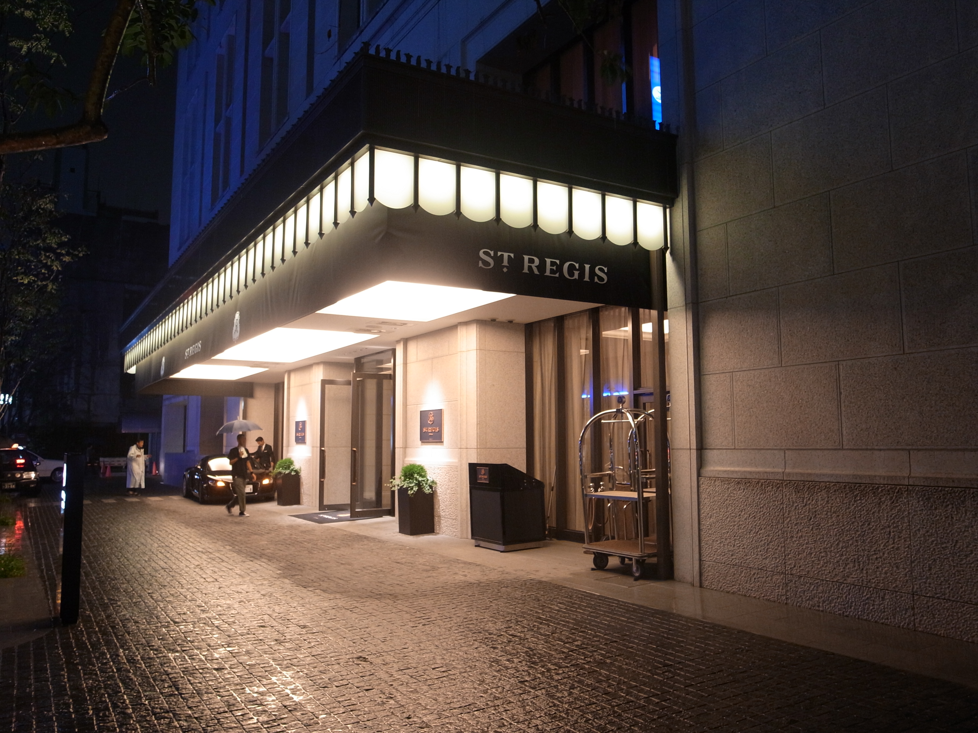
AtliQ Hospitality Analysis

Slide 2
Introduction
Atliq Grands owns multiple five-star hotels across India. They have been
in the hospitality industry for the past 20 years. Due to strategic moves
from other competitors and ineffective decision-making in management,
Atliq Grands are losing its market share and revenue in the luxury/business
hotels category.
We have to provide insights to the revenue team of Altiq Hotels by utilizing
the data

Slide 3
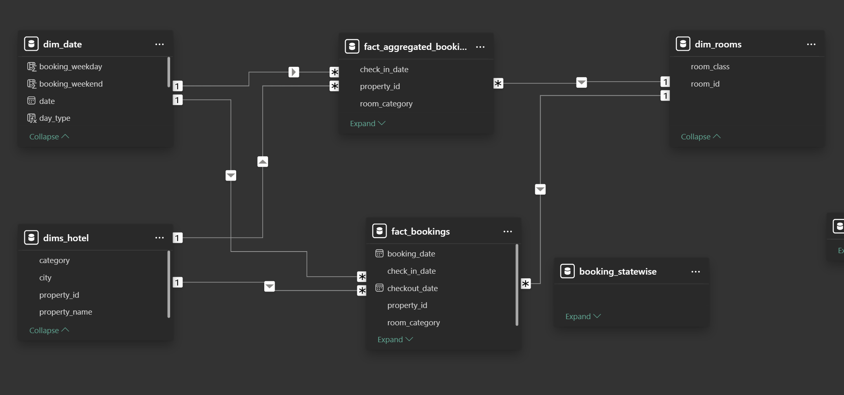
Details of Data

Slide 4
Main KPIs
Regain market share in Luxury/business hotels category
Understanding the revenue trend by week /month/ day
Get Insights were business is failing and what can be done to tackle them

Slide 5
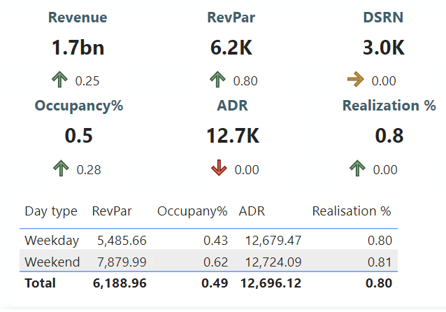
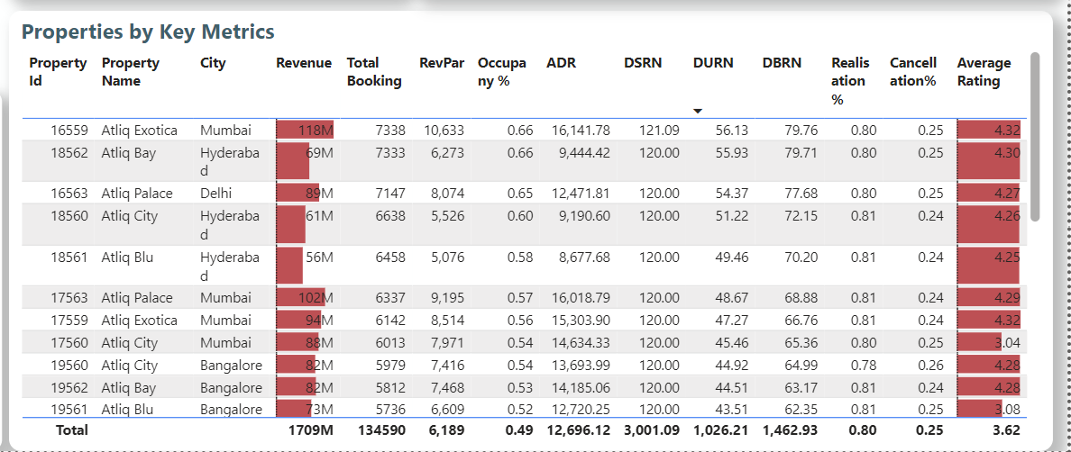
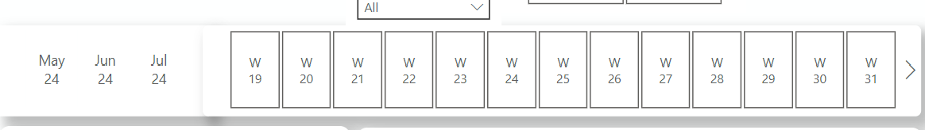
Mock – up Dashboard
Weekly/Month/day change over the metrics
Key Metrics to get the clear overview
Calculating revenue trend by week

Slide 6
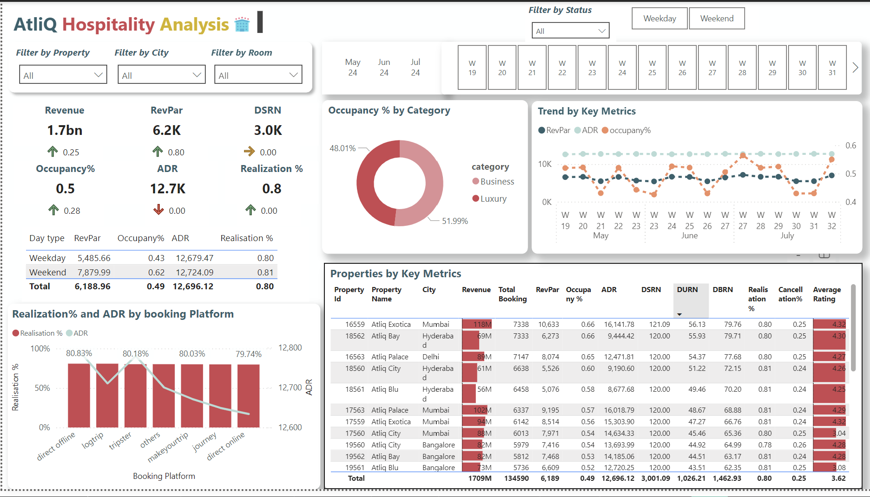
My Design

Slide 7
Thank you

